Slide 1
Chapter 6 z-Transform

Slide 2
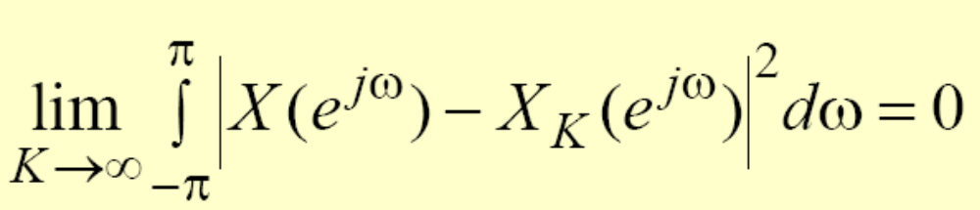
Convergence condition of DTFT
x[n] is an absolutely summable sequence
mean-square convergence
Dirac delta function δ(ω)

Slide 3
z-Transform
The DTFT provides a frequency-domain representation of discrete-time signals and LTI discrete-time systems
Because of the convergence condition, in many cases, the DTFT of a sequence may not exist
As a result, it is not possible to make use of such frequency-domain characterization in these cases

Slide 4
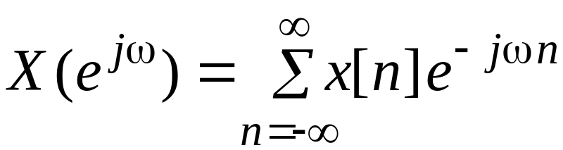
z-Transform
A generalization of the DTFT defined by
leads to the z-transform
z-transform may exist for many sequences for which the DTFT does not exist
Moreover, use of z-transform techniques permits simple algebraic manipulations
代数运算

Slide 5
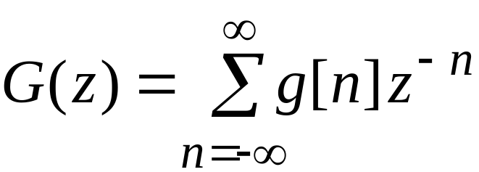

Definition and Properties
Consequently, z-transform has become an important tool in the analysis and design of digital filters
For a given sequence g[n], its z-transform G(z) is defined as
where is a complex variable

Slide 6
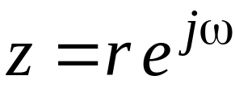
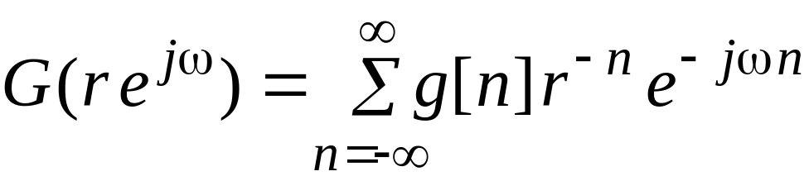
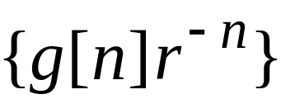
Definition and Properties
If we let , then the z-transform reduces to
The above can be interpreted as the DTFT of the modified sequence
For r = 1 (i.e., |z| = 1), z-transform reduces to its DTFT, provided the latter exists

Slide 7
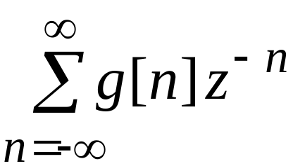
Definition and Properties
周线,等高线
The contour |z| = 1 is a circle in the z-plane of unity radius and is called the unit circle
Like the DTFT, there are conditions on the convergence of the infinite series
For a given sequence, the set R of values of z for which its z-transform converges is called the region of convergence (ROC)

Slide 8
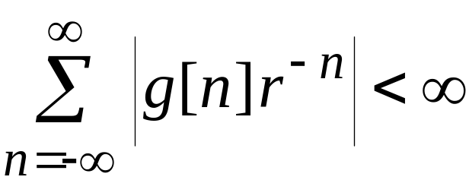
Definition and Properties
From our earlier discussion on the uniform convergence of the DTFT, it follows that the series
converges if is absolutely summable, i.e., if

Slide 9
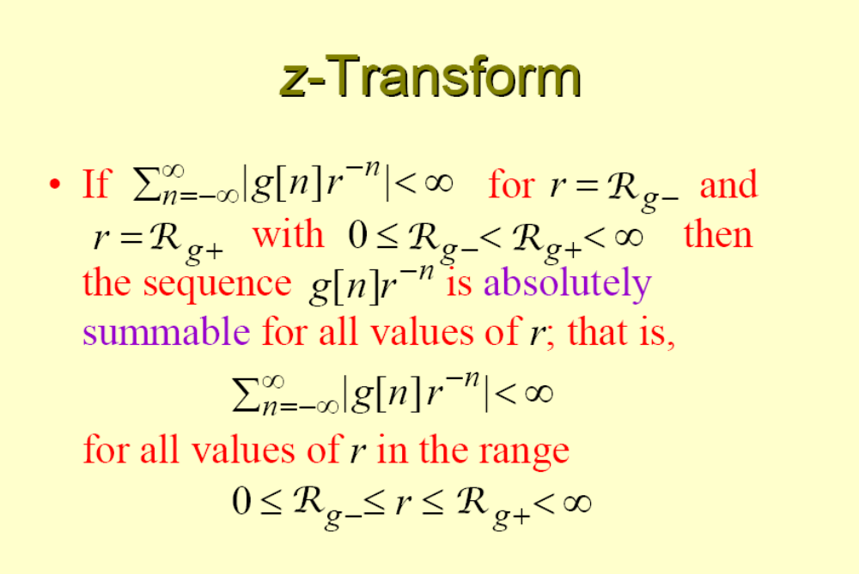

Slide 10
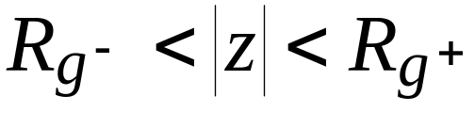
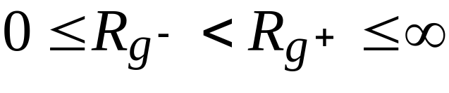


Definition and Properties
In general, the ROC of a z-transform of a sequence g[n] is an annular region of the z-plane:
where
ROC

Slide 11
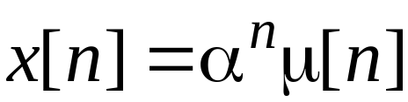
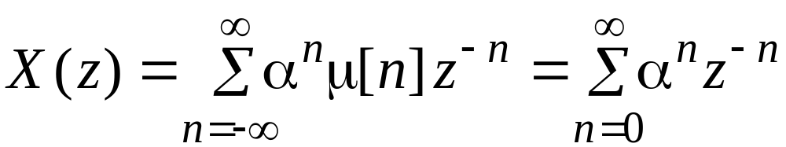
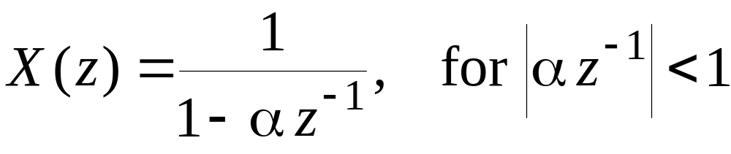
Definition and Properties
Example - Determine the z-transform X(z) of the causal sequence and its ROC
Now
The above power series converges to
ROC is the annular region |z| > |α|

Slide 12
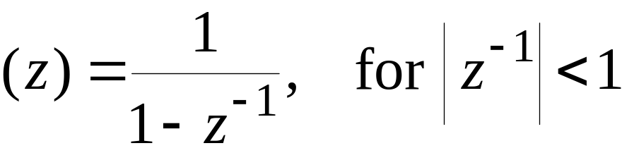
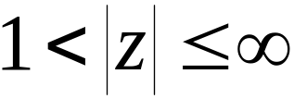
Definition and Properties
Example - The z-transform μ(z) of the unit step sequence μ[n] can be obtained from
by setting α = 1:
ROC is the annular region
μ

Slide 13
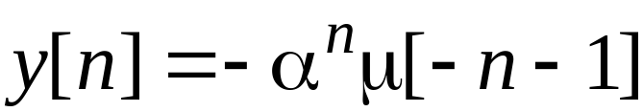
Definition and Properties
Note: The unit step sequence μ[n] is not absolutely summable, and hence its DTFT does not converge uniformly
Example - Consider the anti-causal sequence

Slide 14
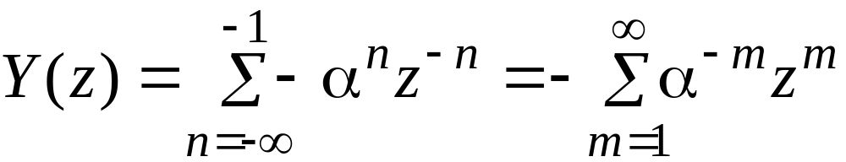
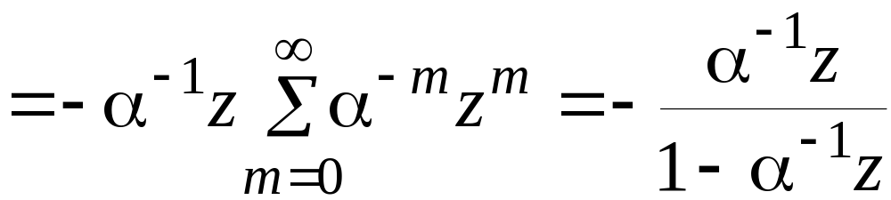
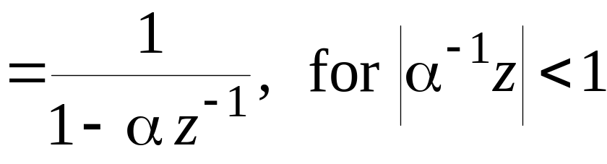
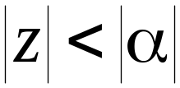
Definition and Properties
Its z-transform is given by
ROC is the annular region

Slide 15
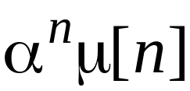
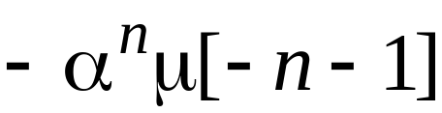
Definition and Properties
Note: The z-transforms of the two sequences and are identical even though the two parent sequences are different
Only way a unique sequence can be associated with a z-transform is by specifying its ROC

Slide 16
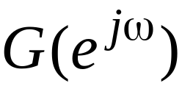
Definition and Properties
The DTFT of a sequence g[n] converges uniformly if and only if the ROC of the z-transform G(z) of g[n] includes the unit circle
The existence of the DTFT does not always imply the existence of the z-transform

Slide 17
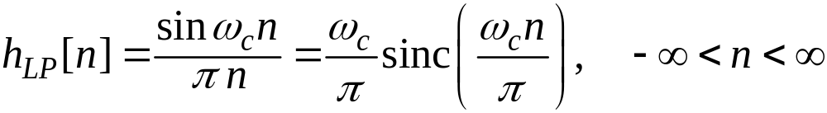
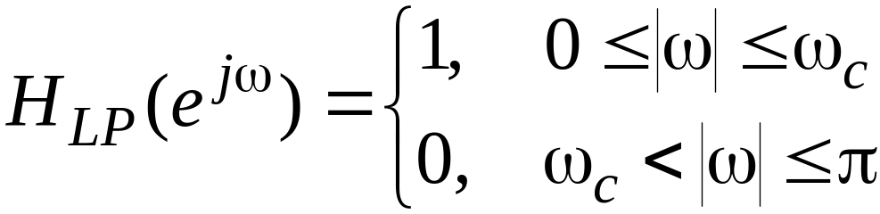
Definition and Properties
Example - The finite energy sequence
has a DTFT given by
which converges in the mean-square sense

Slide 18

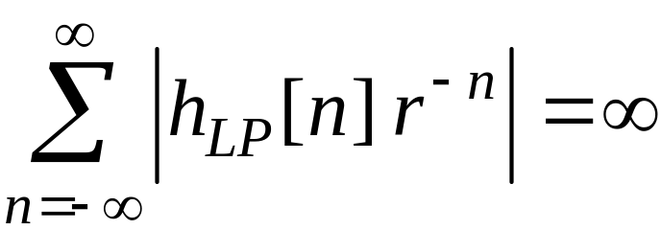

Definition and Properties
However, does not have a z-transform as it is not absolutely summable for any value of r, i.e.
Some commonly used z-transform pairs are listed on the next slide

Slide 19
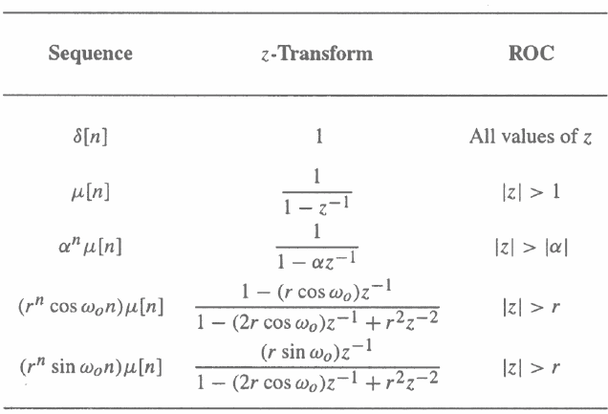
Commonly Used z-Transform Pairs

Slide 20
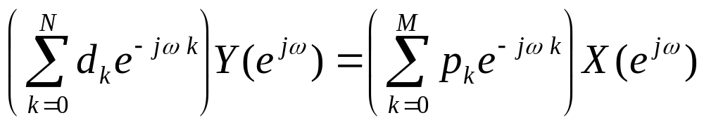
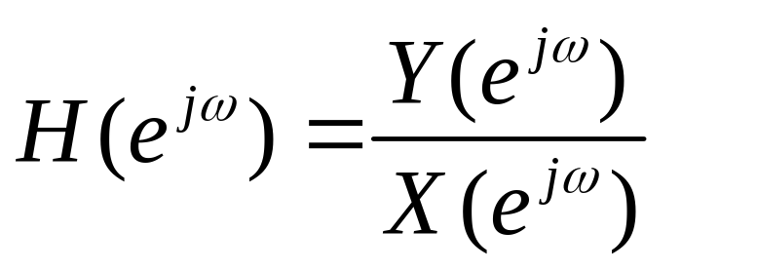
Frequency response

Slide 21
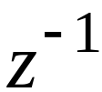
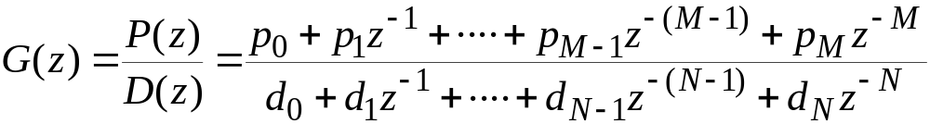
Rational z-Transforms
In the case of LTI discrete-time systems we are concerned with in this course, all pertinent z-transforms are rational functions of
That is, they are ratios of two polynomials in :

Slide 22
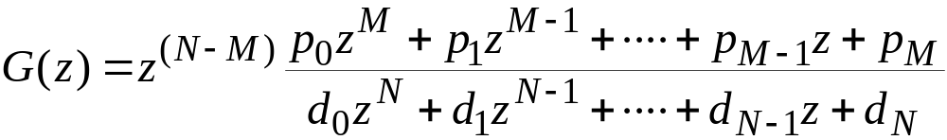
Rational z-Transforms
The degree of the numerator polynomial P(z) is M and the degree of the denominator polynomial D(z) is N
An alternate representation of a rational z-transform is as a ratio of two polynomials in z:

Slide 23
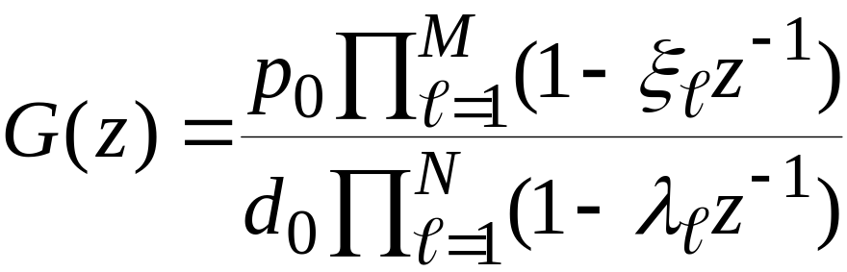
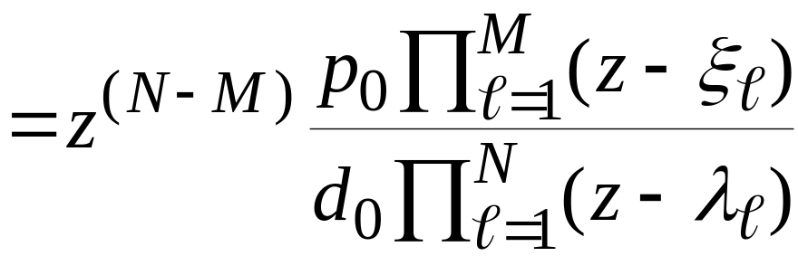
Rational z-Transforms
A rational z-transform can be alternately written in factored form as

Slide 24

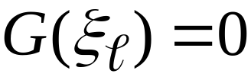

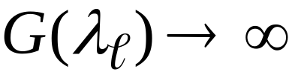
Rational z-Transforms
At a root of the numerator polynomial , and as a result, these values of z are known as the zeros of G(z)
At a root of the denominator polynomial , and as a result, these values of z are known as the poles of G(z)

Slide 25
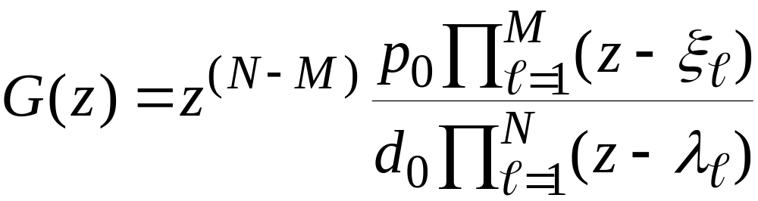


Rational z-Transforms
Consider
Note G(z) has M finite zeros and N finite poles
If N > M there are additional zeros at z = 0 (the origin in the z-plane)
If N < M there are additional poles at z = 0

Slide 26
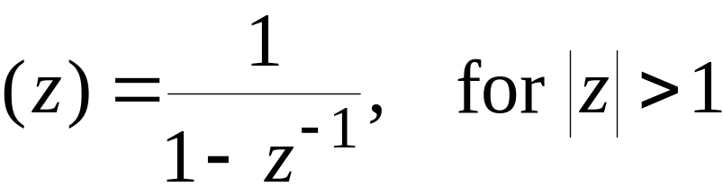
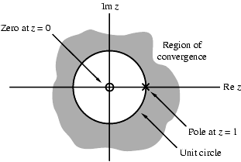
Rational z-Transforms
Example - The z-transform
has a zero at z = 0 and a pole at z = 1
μ

Slide 27
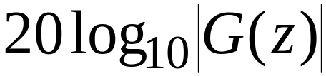
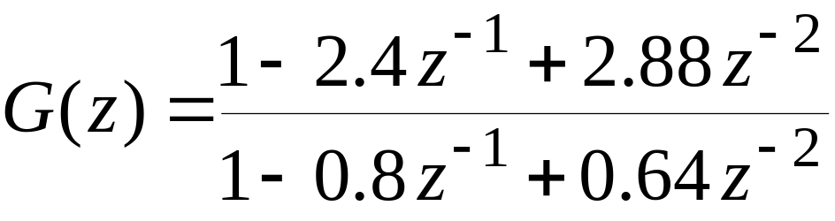
Rational z-Transforms
A physical interpretation of the concepts of poles and zeros can be given by plotting the log-magnitude as shown on next slide for

Slide 28
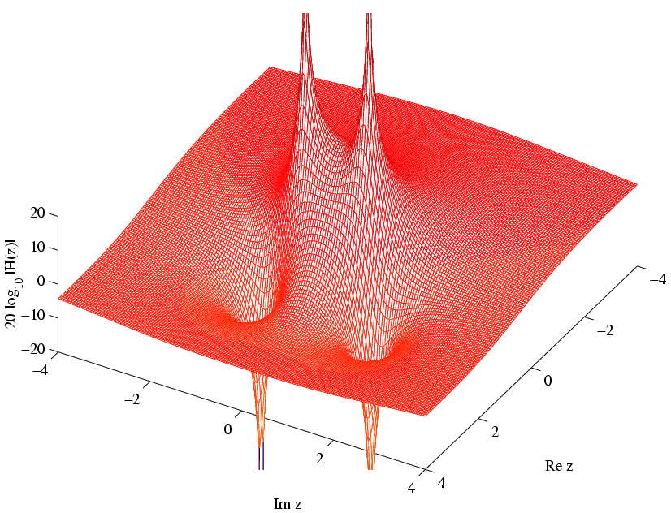
Rational z-Transforms
poles
zeros

Slide 29


Rational z-Transforms
Observe that the magnitude plot exhibits very large peaks around the points which are the poles of G(z)
It also exhibits very narrow and deep wells around the location of the zeros at

Slide 30
ROC of a Rational z-Transform
ROC of a z-transform is an important concept
Without the knowledge of the ROC, there is no unique relationship between a sequence and its z-transform
Hence, the z-transform must always be specified with its ROC

Slide 31
ROC of a Rational z-Transform
Moreover, if the ROC of a z-transform includes the unit circle, the DTFT of the sequence is obtained by simply evaluating the z-transform on the unit circle
There is a relationship between the ROC of the z-transform of the impulse response of a causal LTI discrete-time system and its BIBO stability

Slide 32
ROC of a Rational z-Transform
The ROC of a rational z-transform is bounded by the locations of its poles
To understand the relationship between the poles and the ROC, it is instructive to examine the pole-zero plot of a z-transform
Consider again the pole-zero plot of the z-transform μ(z)

Slide 33
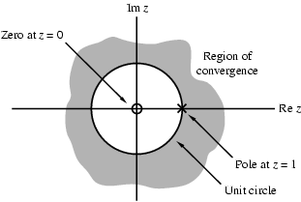
ROC of a Rational z-Transform
In this plot, the ROC, shown as the shaded area, is the region of the z-plane just outside the circle centered at the origin and going through the pole at z = 1

Slide 34
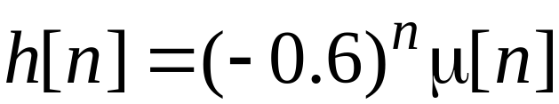
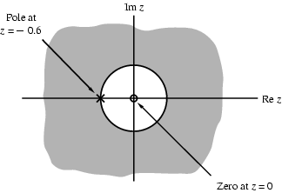
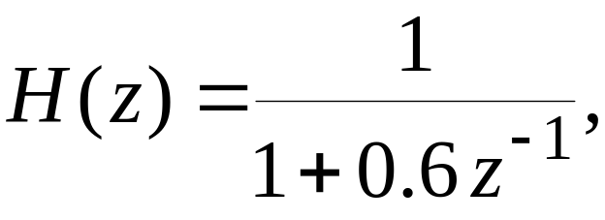
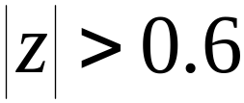

ROC of a Rational z-Transform
Example - The z-transform H(z) of the sequence is given by
Here the ROC is just outside the circle going through the point

Slide 35
ROC of a Rational z-Transform
A sequence can be one of the following types: finite-length, right-sided, left-sided and two-sided
In general, the ROC depends on the type of the sequence of interest

Slide 36

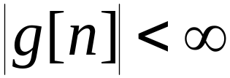
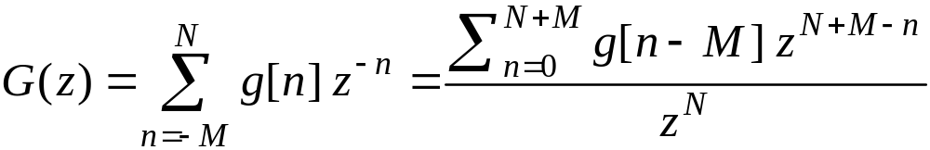
ROC of a Rational z-Transform
Example - Consider a finite-length sequence g[n] defined for , where M and N are non-negative integers and
Its z-transform is given by

Slide 37

ROC of a Rational z-Transform
Note: G(z) has M poles at and N poles at z = 0
As can be seen from the expression for G(z), the z-transform of a finite-length bounded sequence converges everywhere in the z-plane except possibly at z = 0 and/or at

Slide 38



ROC of a Rational z-Transform
Example - A right-sided sequence with nonzero sample values for is sometimes called a causal sequence
Consider a causal sequence
Its z-transform is given by

Slide 39
Example - Determine the z-transform X(z) of the causal sequence and its ROC
Now
The above power series converges to
ROC is the annular region |z| > |α|

Slide 40






ROC of a Rational z-Transform
It can be shown that converges exterior to a circle , including the point
On the other hand, a right-sided sequence with nonzero sample values only for with M nonnegative has a z-transform with M poles at
The ROC of is exterior to a circle , excluding the point

Slide 41



ROC of a Rational z-Transform
Example - A left-sided sequence with nonzero sample values for is sometimes called a anti-causal sequence
Consider an anti-causal sequence
Its z-transform is given by

Slide 42
Its z-transform is given by
ROC is the annular region

Slide 43





ROC of a Rational z-Transform
It can be shown that converges interior to a circle , including the point z = 0
On the other hand, a left-sided sequence with nonzero sample values only for with N nonnegative has a z-transform with N poles at z = 0
The ROC of is interior to a circle , excluding the point z = 0

Slide 44



ROC of a Rational z-Transform
Example - The z-transform of a two-sided sequence w[n] can be expressed as
The first term on the RHS, , can be interpreted as the z-transform of a right-sided sequence and it thus converges exterior to the circle

Slide 45





ROC of a Rational z-Transform
The second term on the RHS, , can be interpreted as the z-transform of a left-sided sequence and it thus converges interior to the circle
If , there is an overlapping ROC given by
If , there is no overlap and the z-transform does not exist

Slide 46



ROC of a Rational z-Transform
Example - Consider the two-sided sequence
where α can be either real or complex
Its z-transform is given by
The first term on the RHS converges for , whereas the second term converges for

Slide 47
ROC of a Rational z-Transform
There is no overlap between these two regions
Hence, the z-transform of does not exist!

Slide 48

ROC of a Rational z-Transform
The ROC of a rational z-transform cannot contain any poles and is bounded by the poles
As an example, assume that a rational z-transform X(z) has two simple poles at z = α and z = β with
There are three possible ROCs associated with X(z)

Slide 49

ROC of a Rational z-Transform
Right-sided
Two-sided
Left-sided

Slide 50

ROC of a Rational z-Transform
In general, if the rational z-transform has N poles with R distinct magnitudes, then it has ROCs
Thus, there are distinct sequences with the same z-transform
Hence, a rational z-transform with a specified ROC has a unique sequence as its inverse z-transform

Slide 51
ROC of a Rational z-Transform
The ROC of a rational z-transform can be easily determined using MATLAB
determines the zeros, poles, and the gain constant of a rational z-transform with the numerator coefficients specified by the vector num and the denominator coefficients specified by the vector den
[z,p,k] = tf2zp(num,den)

Slide 52

ROC of a Rational z-Transform
[num,den] = zp2tf(z,p,k) implements the reverse process
The factored form of the z-transform can be obtained using sos = zp2sos(z,p,k)
The above statement computes the coefficients of each second-order factor given as an matrix sos

Slide 53


ROC of a Rational z-Transform
where

Slide 54
ROC of a Rational z-Transform
The pole-zero plot is determined using the function zplane
The z-transform can be either described in terms of its zeros and poles: zplane(zeros,poles)
or, it can be described in terms of its numerator and denominator coefficients: zplane(num,den)

Slide 55




ROC of a Rational z-Transform
Example - The pole-zero plot of
obtained using MATLAB is shown below

Slide 56


Inverse z-Transform
General Expression: Recall that, for , the z-transform G(z) given by
is merely the DTFT of the modified sequence
Accordingly, the inverse DTFT is thus given by

Slide 57


General Expression
By making a change of variable , the previous equation can be converted into a contour integral given by
where is a counterclockwise contour of integration defined by |z| = r

Slide 58




z-Transform
z-Transform: analysis equation
time domain
z-domain
Inverse z-Transform: synthesis equation

Slide 59

General Expression
But the integral remains unchanged when it is replaced with any contour C encircling the point z = 0 in the ROC of G(z)
The contour integral can be evaluated using the Cauchy’s residue theorem resulting in
The above equation needs to be evaluated at all values of n and is not pursued here
留数定理

Slide 60
Inverse Transform by
Partial-Fraction Expansion
A rational z-transform G(z) with a causal inverse transform g[n] has a ROC that is exterior to a circle
Here it is more convenient to express G(z) in a partial-fraction expansion form and then determine g[n] by summing the inverse transform of the individual simpler terms in the expansion

Slide 61




Inverse Transform by
Partial-Fraction Expansion
A rational G(z) can be expressed as
If then G(z) can be re-expressed as
where the degree of is less than N

Slide 62



Inverse Transform by
Partial-Fraction Expansion
The rational function is called a proper fraction
Example - Consider
By long division we arrive at
真分式

Slide 63
Example - Determine the z-transform X(z) of the causal sequence and its ROC
Now
The above power series converges to
ROC is the annular region |z| > |α|

Slide 64


Inverse Transform by
Partial-Fraction Expansion
Example - Let the z-transform H(z) of a causal sequence h[n] be given by
A partial-fraction expansion of H(z) is then of the form

Slide 65


Inverse Transform by
Partial-Fraction Expansion
Now
and

Slide 66

Inverse Transform by
Partial-Fraction Expansion
Hence
The inverse transform of the above is therefore given by

Slide 67



Inverse Transform by
Partial-Fraction Expansion
Simple Poles: In most practical cases, the rational z-transform of interest G(z) is a proper fraction with simple poles
Let the poles of G(z) be at ,
A partial-fraction expansion of G(z) is then of the form

Slide 68




Inverse Transform by
Partial-Fraction Expansion
The constants in the partial-fraction expansion are called the residues and are given by
Each term of the sum in partial-fraction expansion has a ROC given by and, thus, has an inverse transform of the form

Slide 69

Inverse Transform by
Partial-Fraction Expansion
Therefore, the inverse transform g[n] of G(z) is given by
Note: The above approach with a slight modification can also be used to determine the inverse of a rational z-transform of a noncausal sequence

Slide 70



Inverse Transform by
Partial-Fraction Expansion
Multiple Poles: If G(z) has multiple poles, the partial-fraction expansion is of slightly different form
Let the pole at z = ν be of multiplicity L and the remaining poles be simple and at ,

Slide 71




Inverse Transform by
Partial-Fraction Expansion
Then the partial-fraction expansion of G(z) is of the form
where the constants are computed using
The residues are calculated as before

Slide 72

Partial-Fraction Expansion Using MATLAB
[r,p,k]= residuez(num,den) develops the partial-fraction expansion of a rational z-transform with numerator and denominator coefficients given by vectors num and den
Vector r contains the residues
Vector p contains the poles
Vector k contains the constants

Slide 73
Partial-Fraction Expansion Using MATLAB
[num,den]=residuez(r,p,k) converts a z-transform expressed in a partial-fraction expansion form to its rational form

Slide 74

Inverse z-Transform via Long Division
The z-transform G(z) of a causal sequence {g[n]} can be expanded in a power series in
In the series expansion, the coefficient multiplying the term is then the n-th sample g[n]
For a rational z-transform expressed as a ratio of polynomials in , the power series expansion can be obtained by long division

Slide 75


Inverse z-Transform via Long Division
Example - Consider
Long division of the numerator by the denominator yields
As a result

Slide 76
Inverse z-Transform Using MATLAB
The function impz can be used to find the inverse of a rational z-transform G(z)
The function computes the coefficients of the power series expansion of G(z)
The number of coefficients can either be user specified or determined automatically

Slide 77

Inverse z-Transform Using MATLAB
>> num=[1 2];
>> den=[1 0.4 -0.12];
>> [h,t]=impz(num,den);
>> figure(1)
>> stem(t,h)
>> xlabel('n')
>> ylabel('h[n]')
h[n]=[1.0000 1.6000 -0.5200 0.4000 -0.2224 …]

Slide 78

z-Transform Properties

Slide 79




z-Transform Properties
Example - Consider the two-sided sequence
Let and with X(z) and Y(z) denoting, respectively, their z-transforms
Now
and

Slide 80




z-Transform Properties
Using the linearity property we arrive at
The ROC of V(z) is given by the overlap regions of and
If , then there is an overlap and the ROC is an annular region
If , then there is no overlap and V(z) does not exist

Slide 81



z-Transform Properties
Example - Determine the z-transform and its ROC of the causal sequence
We can express x[n] = v[n] + v*[n] where
The z-transform of v[n] is given by

Slide 82



z-Transform Properties
Using the conjugation property we obtain the z-transform of v*[n] as
Finally, using the linearity property we get

Slide 83




z-Transform Properties
or,
Example - Determine the z-transform Y(z) and the ROC of the sequence
We can write where

Slide 84



z-Transform Properties
Now, the z-transform X(z) of is given by
Using the differentiation property, we arrive at the z-transform of as

Slide 85


z-Transform Properties
Using the linearity property we finally obtain

Slide 86


Slide 87


Slide 88


Slide 89


Slide 90


Slide 91


Slide 92


Slide 93


Slide 94


Slide 95


Slide 96


Slide 97


Slide 98


Slide 99
LTI Discrete-Time Systems in the Transform Domain
An LTI discrete-time system is completely characterized in the time-domain by its implse response sequence {h[n]}
Thus, the transform-domain representation of a discrete-time signal can also be equally applied to the transform-domain representation of an LTI discrete-time system

Slide 100
LTI Discrete-Time Systems in the Transform Domain
Such transform-domain representations provide additional insight into the behavior of such systems
It is easier to design and implement these systems in the transform-domain for certain applications
We consider now the use of the DTFT and the z-transform in developing the transform-domain representations of an LTI system

Slide 101

LTI Discrete-Time Systems in the Transform Domain
In this course we shall be concerned with LTI discrete-time systems characterized by linear constant coefficient difference equations of the form:

Slide 102

LTI Discrete-Time Systems in the Transform Domain
Applying the z-transform to both sides of the difference equation and making use of the linearity and the time-invariance properties we arrive at
where Y(z) and X(z) denote the z-transforms of y[n] and x[n] with associated ROCs, respectively

Slide 103

LTI Discrete-Time Systems in the Transform Domain
A more convenient form of the z-domain representation of the difference equation is given by

Slide 104

The Transfer Function
传输函数
A generalization of the frequency response function
The convolution sum description of an LTI discrete-time system with an impulse response h[n] is given by

Slide 105



Definition
Taking the z-transforms of both sides we get

Slide 106




Definition
Or,
Therefore,
Thus, Y(z) = H(z)X(z)

Slide 107

Definition
Hence,
The function H(z), which is the z-transform of the impulse response h[n] of the LTI system, is called the transfer function or the system function
The inverse z-transform of the transfer function H(z) yields the impulse response h[n]

Slide 108


Transfer Function Expression
Consider an LTI discrete-time system characterized by a difference equation
Its transfer function is obtained by taking the z-transform of both sides of the above equation
Thus

Slide 109


Transfer Function Expression
Or, equivalently as
An alternate form of the transfer function is given by

Slide 110





Transfer Function Expression
Or, equivalently as
are the finite zeros, and are the finite poles of H(z)
If N > M, there are additional zeros at z = 0
If N < M, there are additional poles at z = 0

Slide 111

Transfer Function Expression
For a causal IIR digital filter, the impulse response is a causal sequence
The ROC of the causal transfer function
is thus exterior to a circle going through the pole farthest from the origin
Thus the ROC is given by

Slide 112




Transfer Function Expression
Example - Consider the M-point moving-average FIR filter with an impulse response
Its transfer function is then given by

Slide 113




Transfer Function Expression
The transfer function has M zeros on the unit circle at ,
There are poles at z = 0 and a single pole at z = 1
The pole at z = 1 exactly cancels the zero at z = 1
The ROC is the entire z-plane except z = 0
M = 8

Slide 114

Transfer Function Expression
Example - A causal LTI IIR digital filter is described by a constant coefficient difference equation given by
Its transfer function is therefore given by

Slide 115





Transfer Function Expression
Alternate forms:
Note: Poles farthest from z = 0 have a magnitude
ROC:

Slide 116




Frequency Response from Transfer Function
If the ROC of the transfer function H(z) includes the unit circle, then the frequency response of the LTI digital filter can be obtained simply as follows:
For a real coefficient transfer function H(z) it can be shown that

Slide 117

Frequency Response from Transfer Function
For a stable rational transfer function in the form
the factored form of the frequency response is given by

Slide 118



Frequency Response from Transfer Function
It is convenient to visualize the contributions of the zero factor and the pole factor from the factored form of the frequency response
The magnitude function is given by

Slide 119


Frequency Response from Transfer Function
which reduces to
The phase response for a rational transfer function is of the form

Slide 120

Frequency Response from Transfer Function
The magnitude-squared function of a real-coefficient transfer function can be computed using

Slide 121
Geometric Interpretation of Frequency Response Computation
The factored form of the frequency response
is convenient to develop a geometric interpretation of the frequency response computation from the pole-zero plot as ω varies from 0 to 2π on the unit circle

Slide 122


Geometric Interpretation of Frequency Response Computation
The geometric interpretation can be used to obtain a sketch of the response as a function of the frequency
A typical factor in the factored form of the frequency response is given by
where is a zero if it is zero factor or is a pole if it is a pole factor

Slide 123



Geometric Interpretation of Frequency Response Computation
As shown below in the z-plane the factor represents a vector starting at the point and ending on the unit circle at

Slide 124
Geometric Interpretation of Frequency Response Computation
顶,尖端,梢
As ω is varied from 0 to 2π, the tip of the vector moves counterclockise from the point z = 1 tracing the unit circle and back to the point z = 1

Slide 125

Geometric Interpretation of Frequency Response Computation
As indicated by
the magnitude response at a specific value of ω is given by the product of the magnitudes of all zero vectors divided by the product of the magnitudes of all pole vectors

Slide 126


Geometric Interpretation of Frequency Response Computation
Likewise, from
we observe that the phase response at a specific value of ω is obtained by adding the phase of the term and the linear-phase term to the sum of the angles of the zero vectors minus the angles of the pole vectors

Slide 127
Geometric Interpretation of Frequency Response Computation
Thus, an approximate plot of the magnitude and phase responses of the transfer function of an LTI digital filter can be developed by examining the pole and zero locations
Now, a zero (pole) vector has the smallest magnitude when ω = φ

Slide 128
Geometric Interpretation of Frequency Response Computation
To highly attenuate signal components in a specified frequency range, we need to place zeros very close to or on the unit circle in this range
Likewise, to highly emphasize signal components in a specified frequency range, we need to place poles very close to or on the unit circle in this range

Slide 129

Stability Condition in Terms of the Pole Locations
A causal LTI digital filter is BIBO stable if and only if its impulse response h[n] is absolutely summable, i.e.,
We now develop a stability condition in terms of the pole locations of the transfer function H(z)
S

Slide 130

Stability Condition in Terms of the Pole Locations
The ROC of the z-transform H(z) of the impulse response sequence h[n] is defined by values of |z| = r for which is absolutely summable
Thus, if the ROC includes the unit circle |z| = 1, then the digital filter is stable, and vice versa

Slide 131
Stability Condition in Terms of the Pole Locations
In addition, for a stable and causal digital filter for which h[n] is a right-sided sequence, the ROC will include the unit circle and entire z-plane including the point
An FIR digital filter with bounded impulse response is always stable

Slide 132
Stability Condition in Terms of the Pole Locations
On the other hand, an IIR filter may be unstable if not designed properly
In addition, an originally stable IIR filter characterized by infinite precision coefficients may become unstable when coefficients get quantized due to implementation

Slide 133

Stability Condition in Terms of the Pole Locations
Example - Consider the causal IIR transfer function
The plot of the impulse response coefficients is shown on the next slide

Slide 134

Stability Condition in Terms of the Pole Locations
As can be seen from the above plot, the impulse response coefficient h[n] decays rapidly to zero value as n increases
h[n]

Slide 135

Stability Condition in Terms of the Pole Locations
The absolute summability condition of h[n] is satisfied
Hence, H(z) is a stable transfer function
Now, consider the case when the transfer function coefficients are rounded to values with 2 digits after the decimal point:
^

Slide 136


Stability Condition in Terms of the Pole Locations
^
A plot of the impulse response of is shown below
^

Slide 137
Stability Condition in Terms of the Pole Locations
In this case, the impulse response coefficient increases rapidly to a constant value as n increases
Hence, the absolute summability condition of is violated
Thus, is an unstable transfer function
^
^

Slide 138


Stability Condition in Terms of the Pole Locations
The stability testing of a IIR transfer function is therefore an important problem
In most cases it is difficult to compute the infinite sum
For a causal IIR transfer function, the sum S can be computed approximately as
S
S
K

Slide 139

Stability Condition in Terms of the Pole Locations
The partial sum is computed for increasing values of K until the difference between a series of consecutive values of is smaller than some arbitrarily chosen small number, which is typically
For a transfer function of very high order this approach may not be satisfactory
An alternate, easy-to-test, stability condition is developed next
S
K

Slide 140

Stability Condition in Terms of the Pole Locations
Consider the causal IIR digital filter with a rational transfer function H(z) given by
Its impulse response {h[n]} is a right-sided sequence
The ROC of H(z) is exterior to a circle going through the pole farthest from z = 0

Slide 141
Stability Condition in Terms of the Pole Locations
But stability requires that {h[n]} be absolutely summable
This in turn implies that the DTFT of {h[n]} exists
Now, if the ROC of the z-transform H(z) includes the unit circle, then

Slide 142



Stability Condition in Terms of the Pole Locations
Conclusion: All poles of a causal stable transfer function H(z) must be strictly inside the unit circle
The stability region (shown shaded) in the z-plane is shown below
j Im z
stability region
Re z
1
unit circle

Slide 143


Stability Condition in Terms of the Pole Locations
Example - The factored form of
is
which has a real pole at z = 0.902 and a real pole at z = 0.943
Since both poles are inside the unit circle, H(z) is BIBO stable

Slide 144


Stability Condition in Terms of the Pole Locations
Example - The factored form of
is
which has a real pole on the unit circle at z = 1 and the other pole inside the unit circle
Since one pole is not inside but on the unit circle, H(z) is unstable
^
^

Slide 145


Exercise 6.2
Determine the z-transform and the corresponding ROC of the following causal sequences:
(a)
(c)

Slide 146


Exercise 6.44
The transfer function of a causal LTI discrete-time system is given by
(a) Determine the impulse response of the above system.
(b) Determine the output of the above system for all values of for an input

